Slide 1
Introduction to Computer Programming Lecture 7:
Classes in Python
Helmut Hauser
Department of Engineering Mathematics
13th November 2019

Slide 2
Additional Drop-in
Today, Nov 13
MVB 2.11
from 1 PM to 5 PM

Slide 3


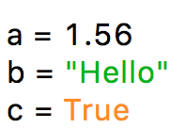
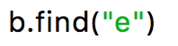
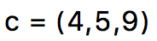
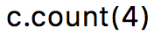
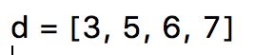
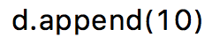
What are classes?
Usually we think of variables and functions as separate entities.
Functions for tuple:
c.count()
c.index()
Variables
Functions
Functions for list:
d.count()
d.index()
d.append()
d.extend()
d.insert()
d.remove()
d.pop()
d.clear()
d.sort()
d.reverse()

Slide 4
What are classes?
Usually we think of variables and functions as separate entities.
Functions for tuple:
c.count()
c.index()
Variables
Functions
Functions for str:
b.find()
b.capitalize()
b.isalpha()
.
.
.
many, many more.…

Slide 5
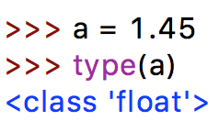
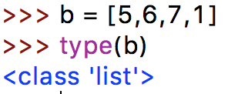

What are classes?
A class could be seen as combing values and corresponding functions in one entity!
MyOwnClass
Variables
Functions
Python is special: All build-in data types are “classes”!
Disclaimer: Note that the idea of classes (object orientated programming) is much more complex (inheritance, encapsulation, polymorphism, etc.)

Slide 6
Let’s make our own class
Example: We want to build a class that represents fractions.
numerator
2
denominator
3
Possible functions:
get float value
print out nicely
get numerator
get denominator
get fraction from float
mathematical functions (addition, multiplication, …)
class specific
functions

Slide 7
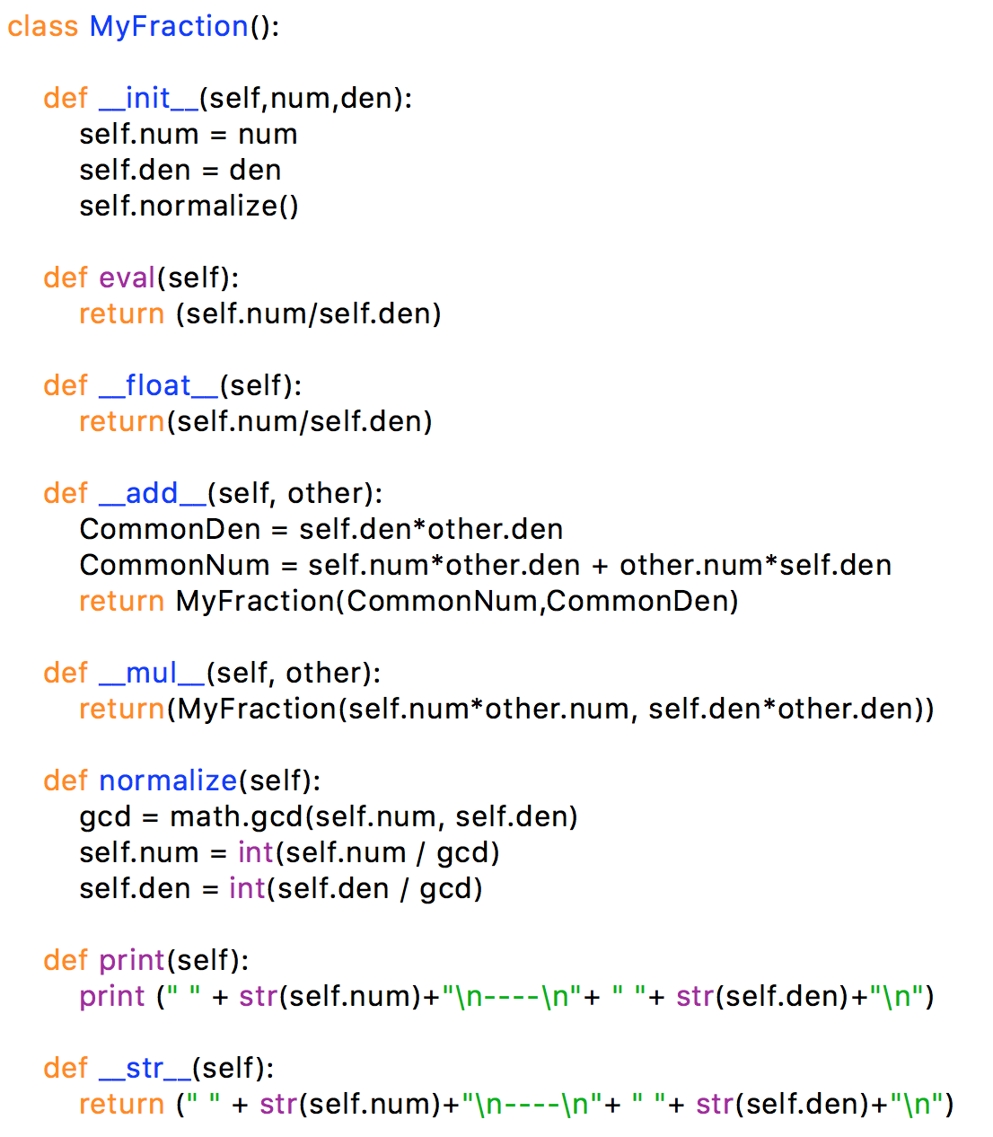

Make your own class
init functions is called every time we initiate a variable of this class
variables of the class
We can provide additional input to init a variable of this class
We can define functions for this class
“self” is a reference to the current instantiation
We can override operators
We can override operators

Slide 8
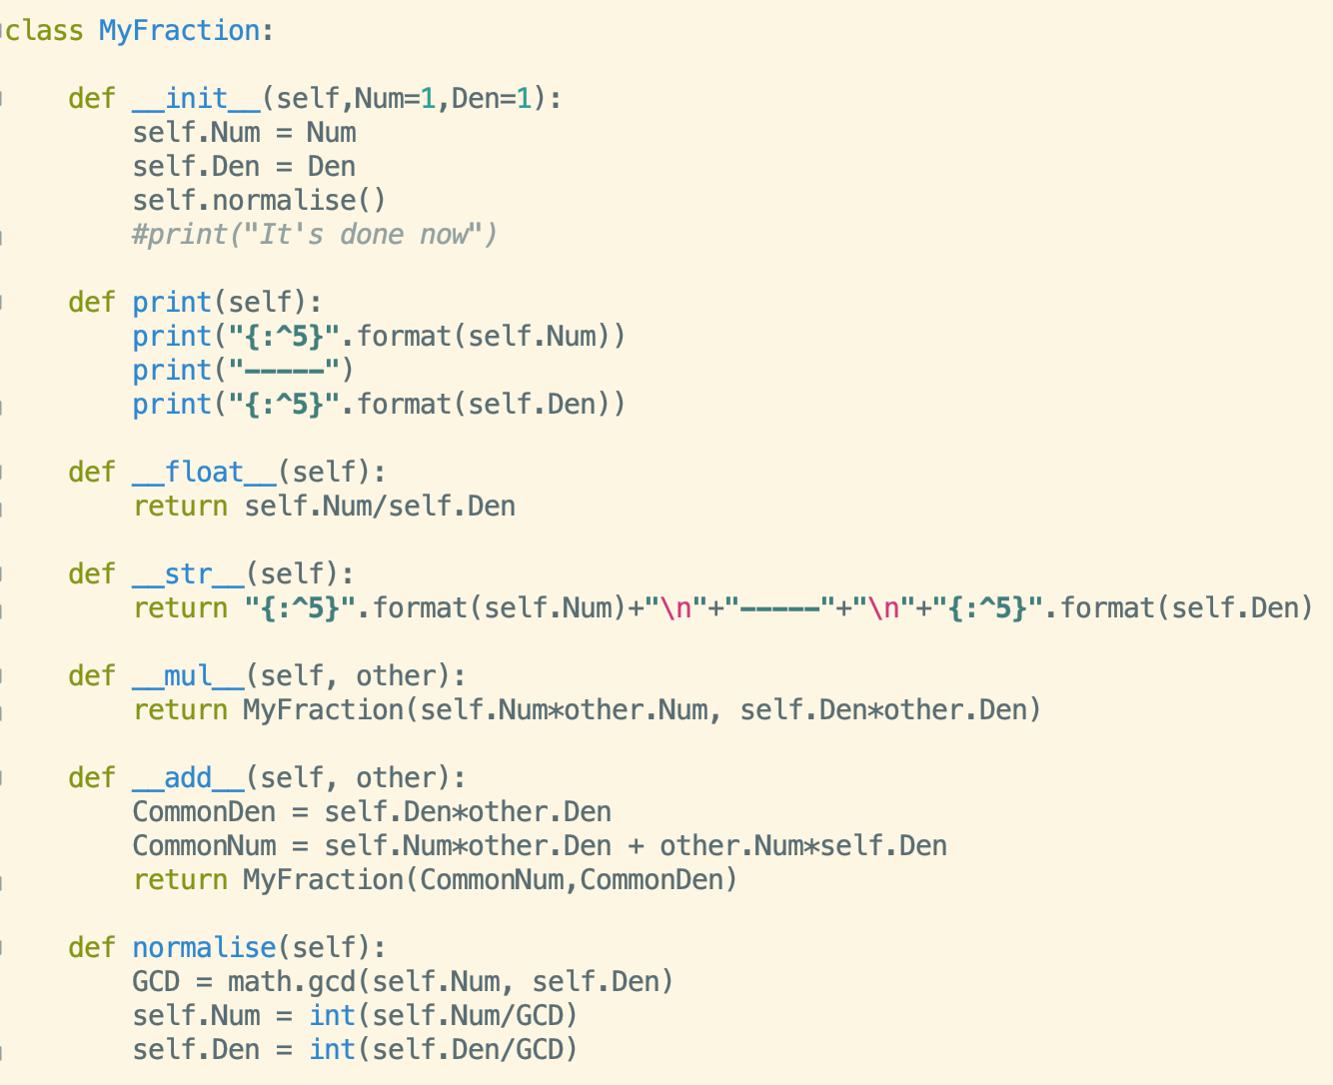
Make your own class
init functions is called every time we initiate a variable of this class
variables of the class
We can provide additional input to init a variable of this class (with default values)
We can define functions for this class
“self” is a reference to the current instantiation
We can override operators
We can override operators

Slide 9
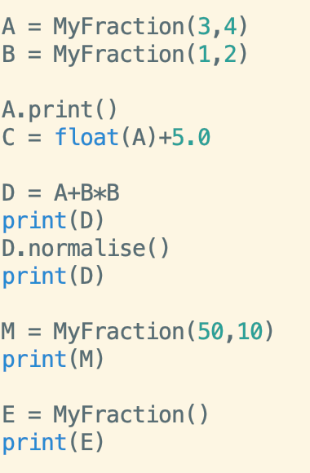
Make your own class
initiate variable with class → __init__ will be called
init functions is called, self.Num = 3 and self.Den = 4
same class, but different instance
self.Num = 1 and self.Den = 2
Use functions of the class with the “.” operator
__float__ will be called
print function needs a string - __str__ will be called
It will use default values
Den =1 and Num =1
We can override operators

Slide 10
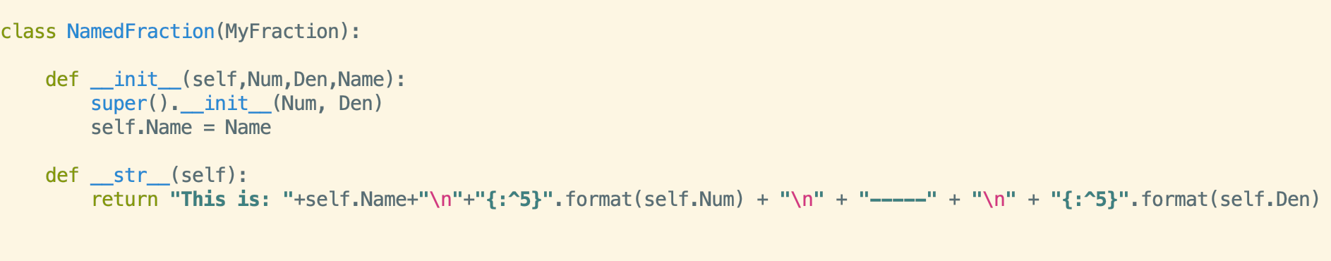
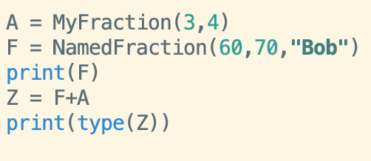
Derive a class
Initialise super class (i.e. the one that you have derived your new class from)
Derive from class “MyFraction”
You can overriding functions for the new class
Same functionality as “MyFraction”, __add__ from MyFraction class
Uses the __str__ from “NamedFraction” instead of “MyFraction”
Will be “MyFraction” since __add__ from MyFraction class was used

Slide 11
Derive a class
Den
__init__
Num
__add__
normalize
MyFraction
display
__str__

Slide 12
Derive a class
Den
__init__
Num
__add__
normalize
MyFraction
print
__str__
Name
__init__
NamedFraction
__str__

Slide 13
NamedFraction is derived from MyFraction
Den
__init__
Num
__add__
normalize
MyFraction
print
super()
__str__
Overriding init functions (and calling in there super().__init__()
Name
__init__
NamedFraction
__str__
Overriding functions

